Slide 1
The best location for a Bed&Breakfast
Barcelona, Spain

Slide 2
Introduction
The client looks for the best location among the 10 districts of Barcelona to host a local accommodation together with a bar.
We are looking for a complex range of competition, as the city is quite touristy.
We will use K-means and basic statistics to perform the search of the best location.

Slide 3
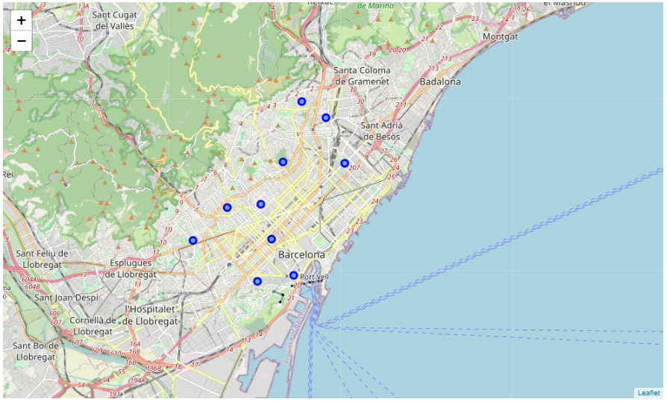
Data
Mainly Wikipedia and Foursquare Api
Here we can see the ten centroids of the Neighbourhoods
From Foursquare we obtained info of the venues on the vecinities

Slide 4

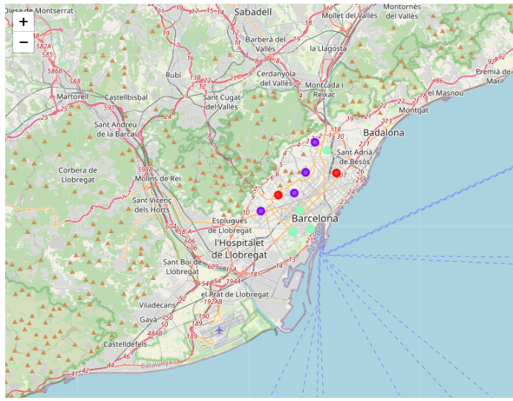
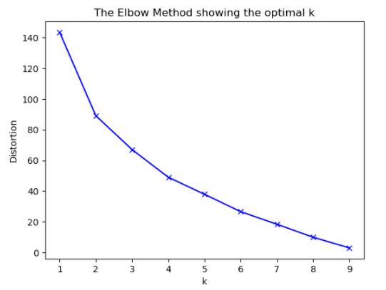
Methodology
K-means clustering was the best decision.
https://towardsdatascience.com/clustering-algorithms-for-customer-segmentation-af637c6830ac
A backgrounder on K-Means clustering “K-means clustering is an iterative clustering algorithm where the number of clusters K is predetermined and the algorithm iteratively assigns each data point to one of the K clusters based on the feature similarity.”
* Key Observation: And for my project feature similarity means restaurant similarity in Neighborhoods *

Slide 5
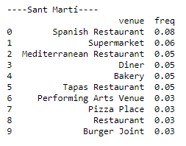
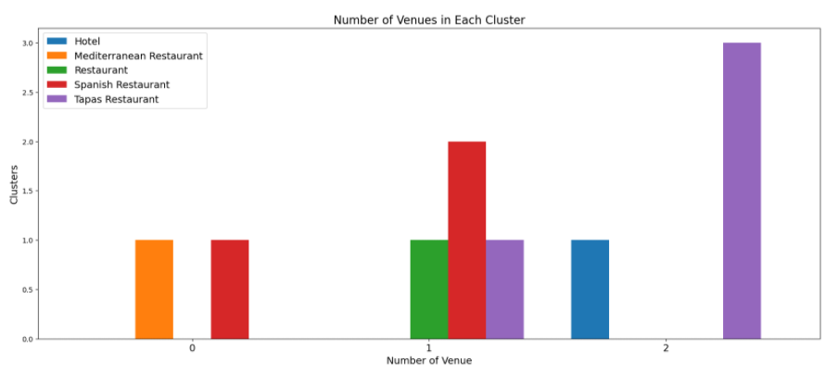
Results
After the screening that allows us to do k-means, we decided on the Sant Martí neighborhood.
This neighborhood is the one that has the best conditions and the best environment to develop a business like the one you want to carry out

